Slide 1
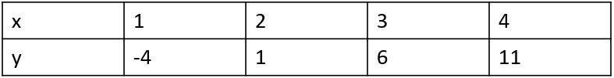
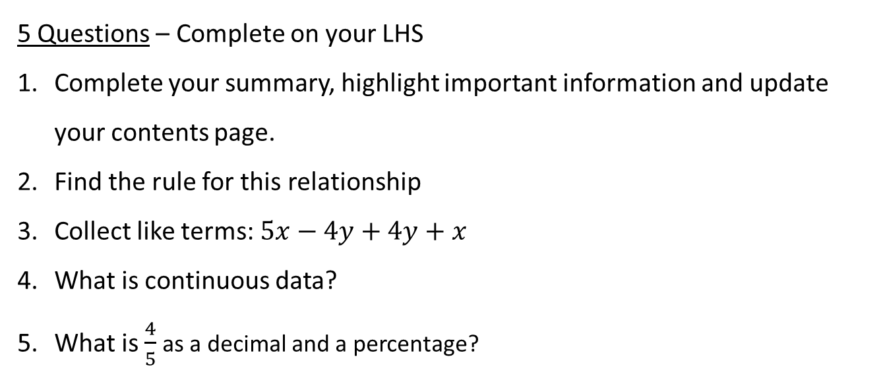
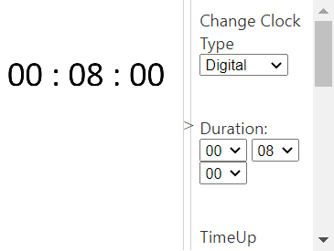
Topic: Linear Relationships in Context
Date: XX/XX/2021
EQ – How can I use linear relationships in real life?
5 Questions – Complete on your LHS
Complete your summary, highlight important information and update your contents page.
Find the rule for this relationship
Collect like terms: $5x−4y+4y+x$
What is continuous data?
What is $\frac{4}{5}$ as a decimal and a percentage?

Slide 2
Yesterday we looked at how we could use linear relationships to find the cost of an electrician. Today we have 3 electrician quotes to compare.
Quote 1= $40 per hour + $100 call out fee
Starts at $100 this is the y-intercept (C)
goes up each hour $40 This is the gradient
y=Mx + C becomes y= ____x + _____
Quote 2 = $150 call out fee and $35 per hour
Starts at $150 this is the y-intercept (C)
goes up each hour $35 This is the gradient
y=Mx + C becomes y= ____x + _____
Quote 3 = $50 call out fee and $50 per hour
Starts at $50 this is the y-intercept (C) goes up each hour $50 This is the gradient
y=Mx + C becomes y= ____x + _____
We need to decide which is the cheapest quote.

Slide 3
We could look at all 3 as tables.
Quote 1 cost = $40 x hours +$100 or y=40x +100
Quote 2 cost = $150 + $35 per hour or ________________
Quote 3 cost = $50 + $35 per hour or ________________
Hours (x) | 0 | 1 | 2 | 3 | 4 | 5 | 6
Cost (y) | 100 | 140 | 180 | 220 | 260 | 300 | 340
Hours | 0 | 1 | 2 | 3 | 4 | 5 | 6
Cost
Hours | 0 | 1 | 2 | 3 | 4 | 5 | 6
Cost

Slide 4
We can also use these tables to get the rules.
Quote 1 cost = $40 x hours +$100 or y=40x +100
Quote 2 cost = $150 + $35 per hour or ________________
Quote 3 cost = $50 per hour + $50 or ________________
Hours | 0 | 1 | 2 | 3 | 4 | 5 | 6
Cost | 100 | 140 | 180 | 220 | 260 | 300 | 340
Hours | 0 | 1 | 2 | 3 | 4 | 5 | 6
Cost | 150 | 185 | 220 | 255 | 290 | 325 | 360
Hours | 0 | 1 | 2 | 3 | 4 | 5 | 6
Cost | 50 | 100 | 150 | 200 | 250 | 300 | 350

Slide 5
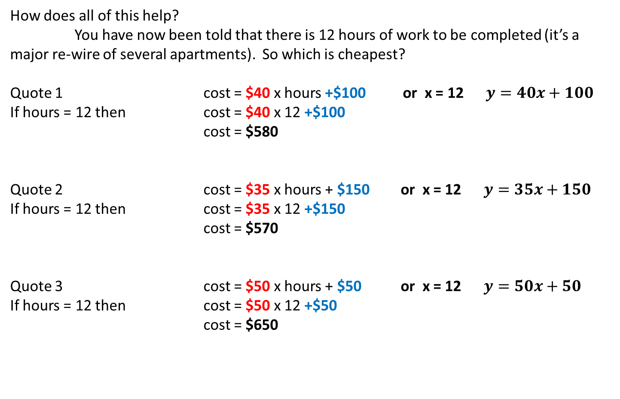
How does all of this help?
You have now been told that there is 12 hours of work to be completed (it’s a major re-wire of several apartments). So which is cheapest?
Quote 1 cost = $40 x hours +$100 or x = 12 $y=40x+100$
If hours = 12 then cost = $40 x 12 +$100
cost = $580
Quote 2 cost = $35 x hours + $150 or x = 12 $y=35x+150$
If hours = 12 then cost = $35 x 12 +$150
cost = $570
Quote 3 cost = $50 x hours + $50 or x = 12 $y=50x+50$
If hours = 12 then cost = $50 x 12 +$50
cost = $650

Slide 6
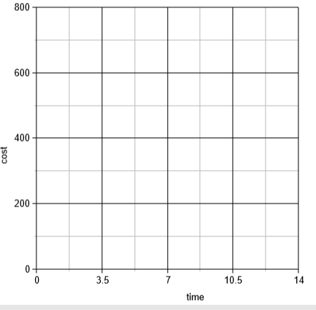
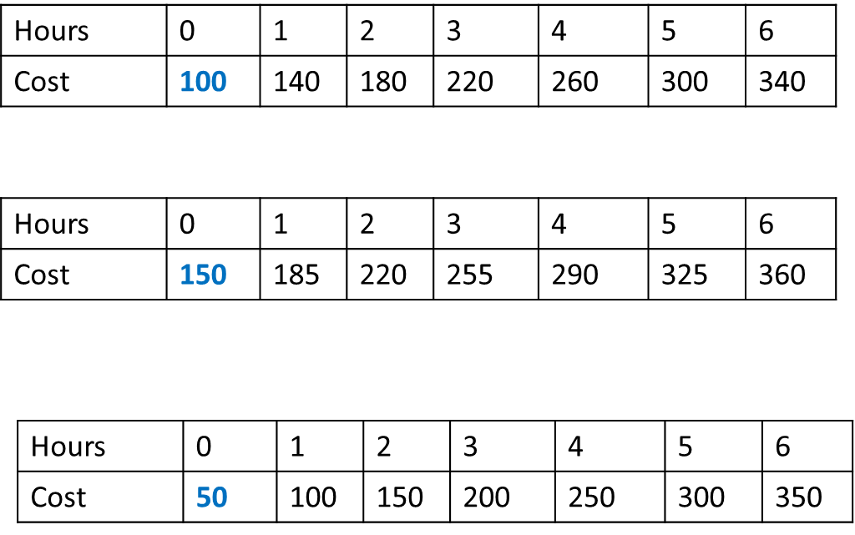
Finally, What happens when we graph these equations?

Slide 7
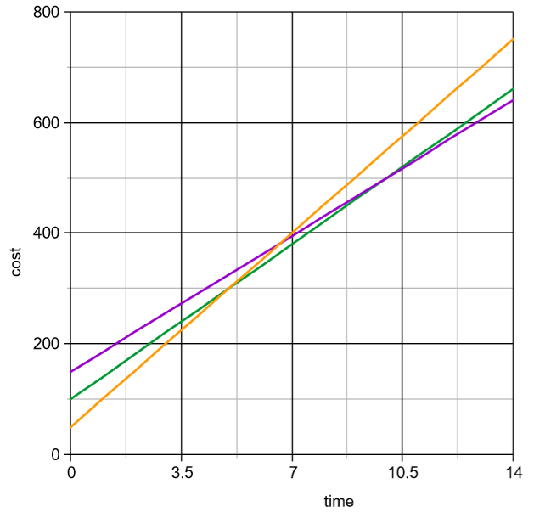
Finally, What happens when we graph these equations?
Which is the cheapest option at these three sections of the graph?

Slide 8
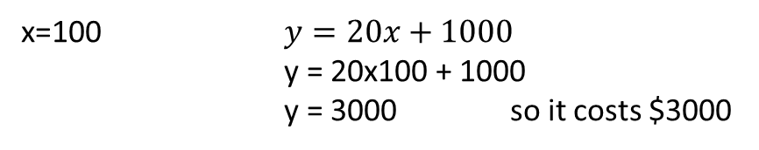
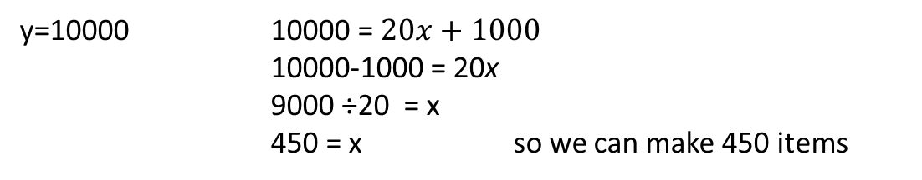
Topic : Linear relationships in context
EQ – How can I use linear relationships in real life?
Linear equations can be used to describe many real situations.
Example
To manufacture a new product it costs $1000 to create the equipment and then $20 per item thereafter.
Starts at $1000 this is the y-intercept (C)
goes up each time $20 This is the gradient M
So $y=Mx+c becomes y=20x+1000$
What is the total cost to make 100 items
x=100 $y=20x+1000$
y = 20x100 + 1000
y = 3000 so it costs $3000
How many items can you make for $10000
y=10000 10000 = $20x+1000$
10000-1000 = 20x
9000 ÷20 = x
450 = x so we can make 450 items

Slide 9
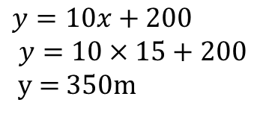

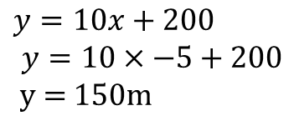
Have a go!
1.
Cohen’s motorbike is 200m ahead of Darcy’s and is increasing its lead by 10m every minute.
Starts at 200 this is the y-intercept (C)
Goes up each minute by 10 This is the gradient
What is the equation?
How far in front will Cohen be in 15 minutes?
How far in front was Cohen 5 minutes ago?
$$y=10x+200 which means distance=10×minutes+200$$
15 Minutes ago means x =15
$$y=10x+200$$
$$y=10×15+200$$
y = 350m
5 Minutes ago means$x =−5$
$$y=10x+200$$
$$y=10×−5+200$$
y = 150m

Slide 10

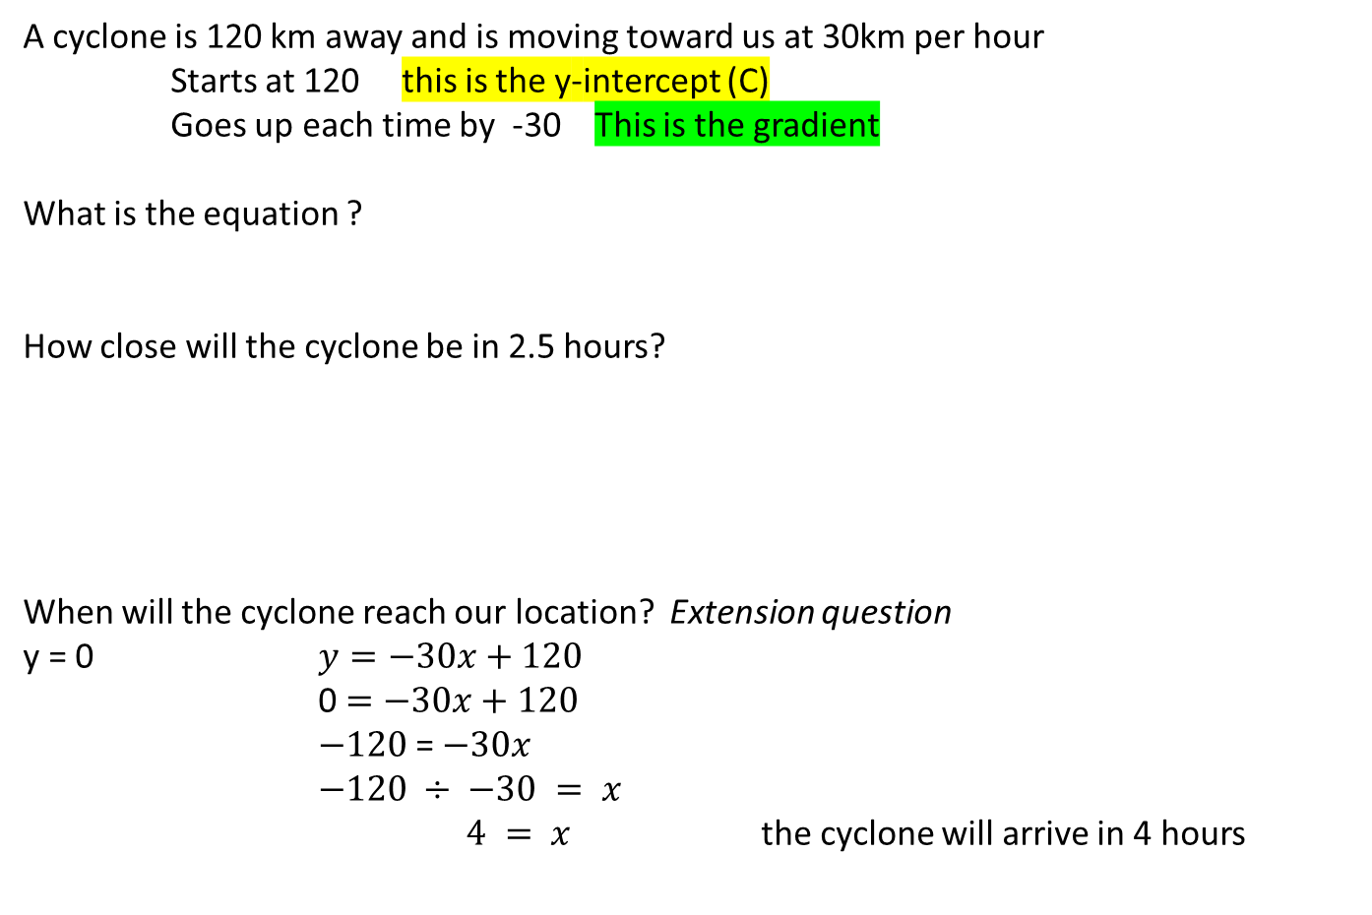
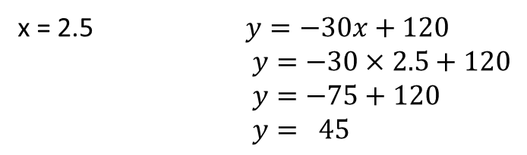
Have a go!
2.
A cyclone is 120 km away and is moving toward us at 30km per hour
Starts at 120 this is the y-intercept (C)
Goes up each time by -30 This is the gradient
What is the equation ?
How close will the cyclone be in 2.5 hours?
When will the cyclone reach our location? Extension question
y = 0 $y=−30x+120$
0 $=−30x+120$
$−120$= $−30x$
$−120 ÷ −30 = x$
$4 = x$ the cyclone will arrive in 4 hours
So $y=−30x+120$
x = 2.5 $y=−30x+120$
$y=−30×2.5+120$
$y=−75+120$
$y= 45$

Slide 11
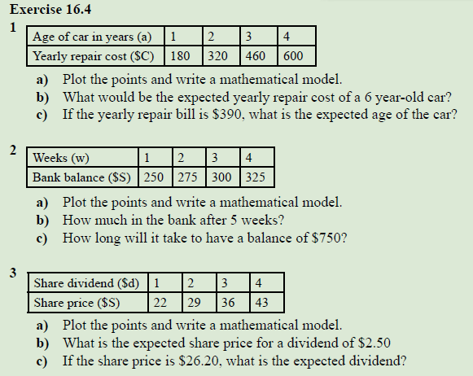
Dr Dwyer
Exercise 16.4
Page 216 and 217
The phrase “write a mathematical model.” means write an equation
After this is done – move onto page 167 and 168 in Dwyer to further extend on the context-based questions.
Notes:
After this is done – move onto page 167 and 168 in Dwyer to further extend on the context based questions.

